Slide 1

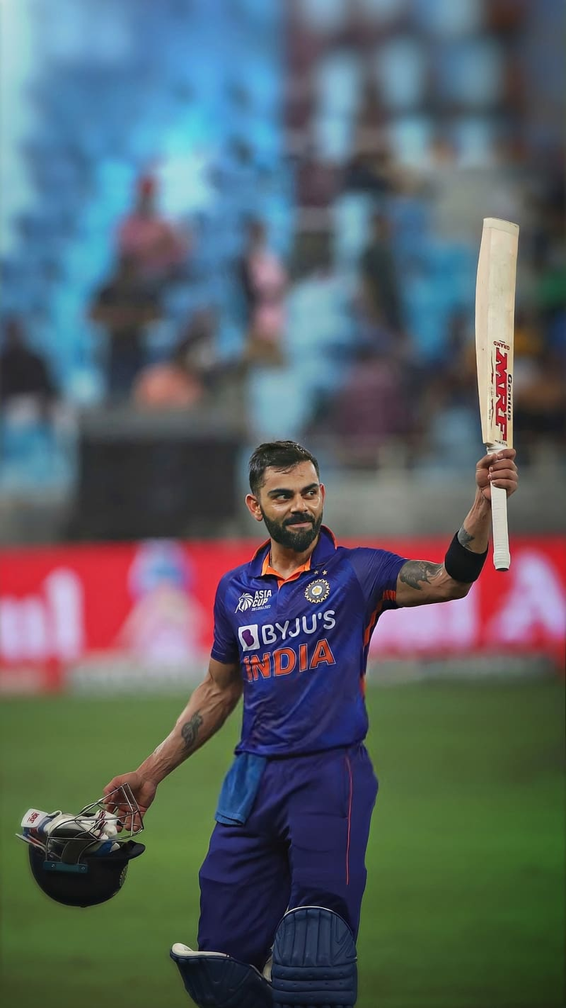

Virat Kohli
Analysis
Tools & Techniques Laboratory Project

Slide 2


Introduction
This presentation presents a comprehensive analysis of the cricket performance of Virat Kohli. Through detailed examination and visualization of his performance data, including runs scored, match formats, opponents faced, venues played, and time periods, we aim to uncover valuable insights into the factors driving his success on the cricket field. The findings of this analysis contribute to a deeper understanding of Virat Kohli's impact on the sport of cricket. By unravelling the intricacies of his performance data, this study sheds light on his remarkable contributions to the game and cements his legacy as one of the greatest batsmen of his generation.

Slide 3
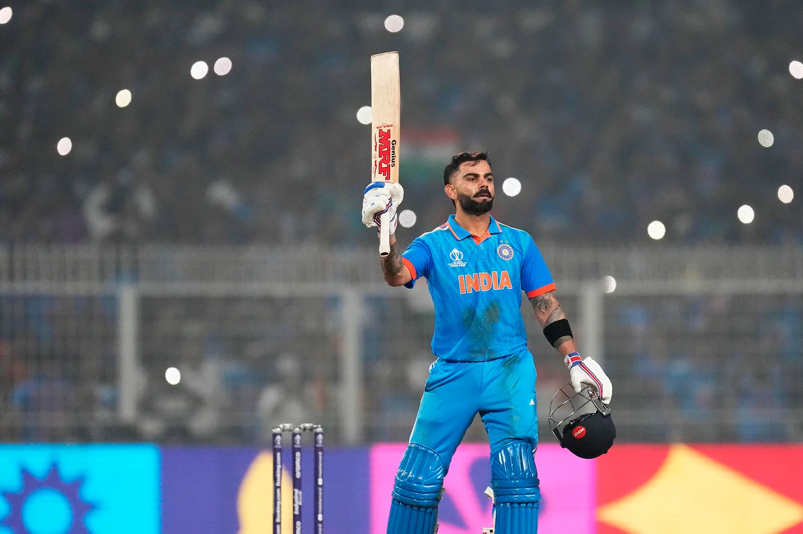


Contents
Data preperation/cleaning
Data visualisation

Slide 4
Data preperation/cleaning
‘head()’, ‘shape’ and ‘info()’ functions/attributes were used to get a general understanding of the data.
‘describe()’ function was used to get the descriptive statistics.
Dataset was checked for any duplicate and null values, and none were found.
Redundant column ‘index’, was dropped.
‘date’ column was changed to a datetime object. Hence, columns for quarter, months and years were created in the dataset.

Slide 5
Data Visualisations

Slide 6
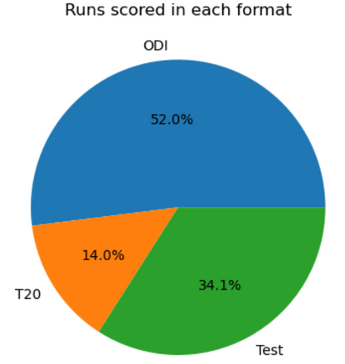
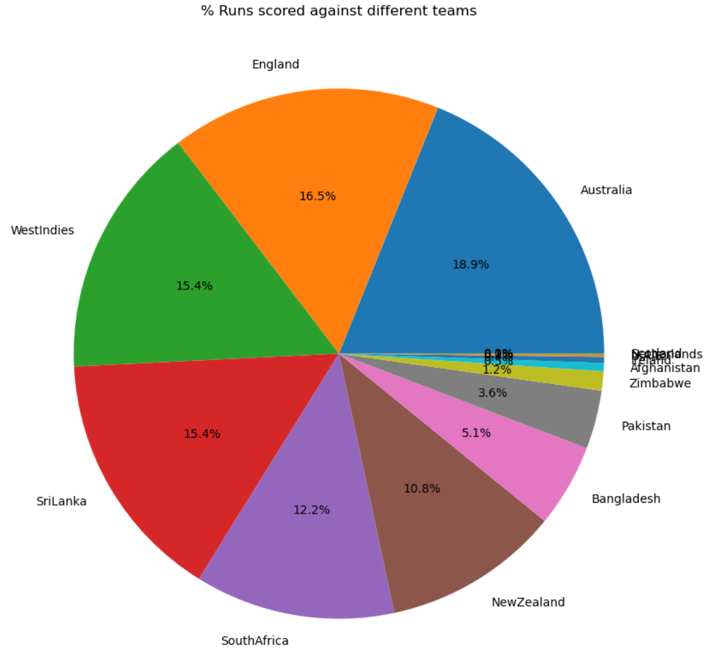
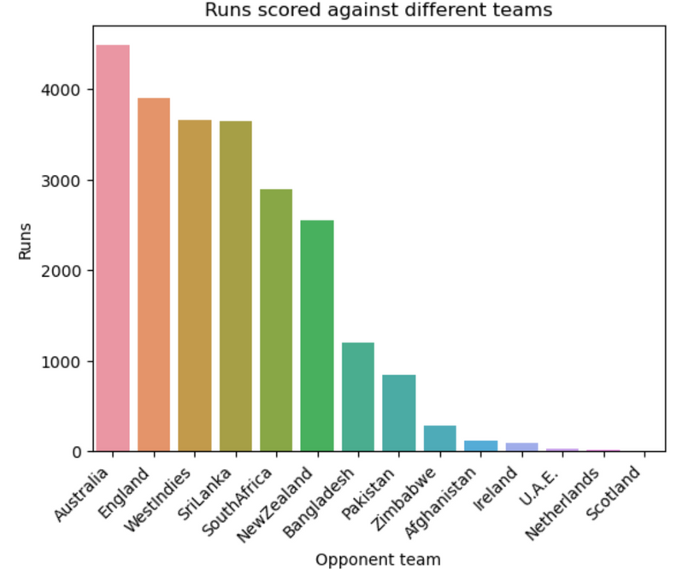

Slide 7
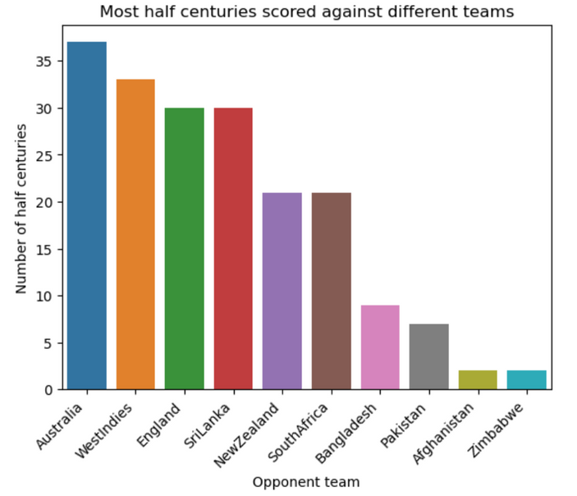
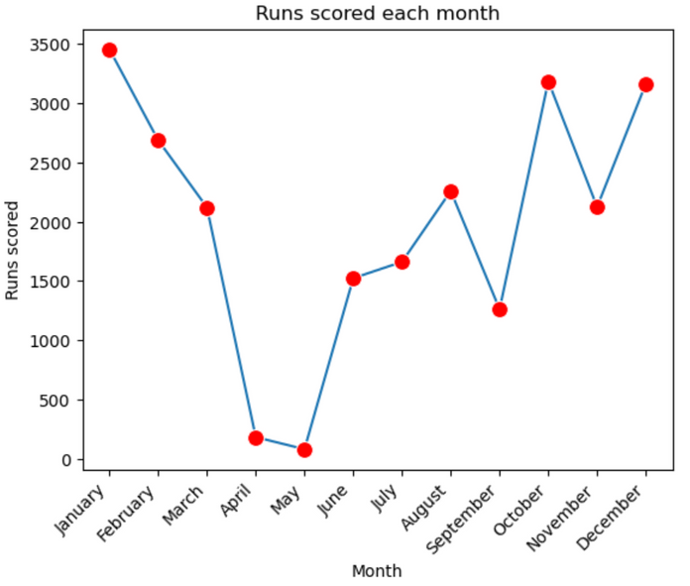
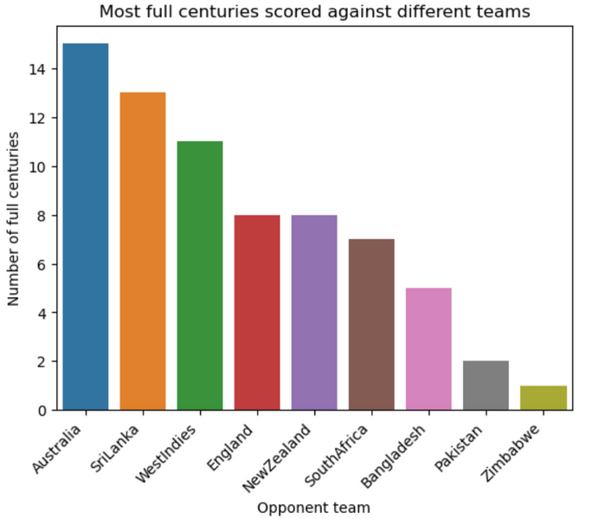
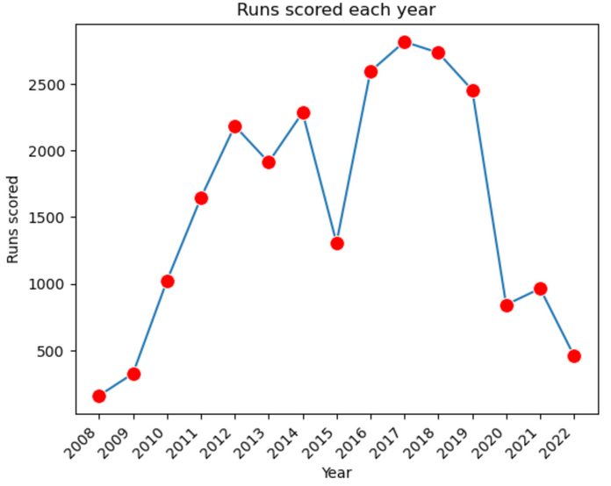

Slide 8
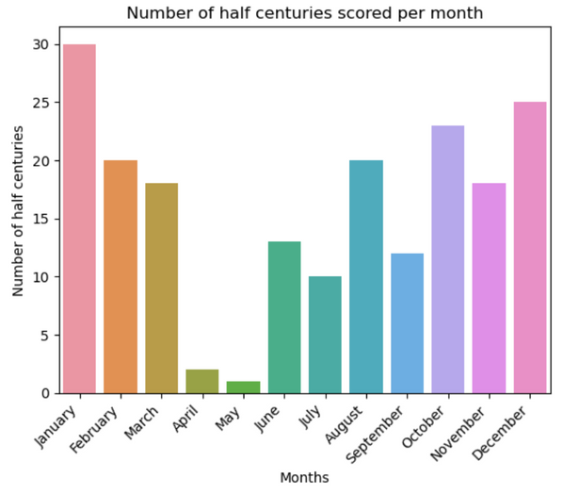
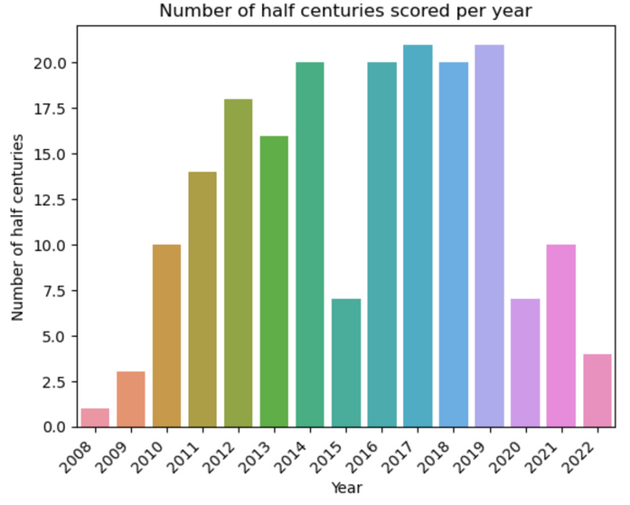
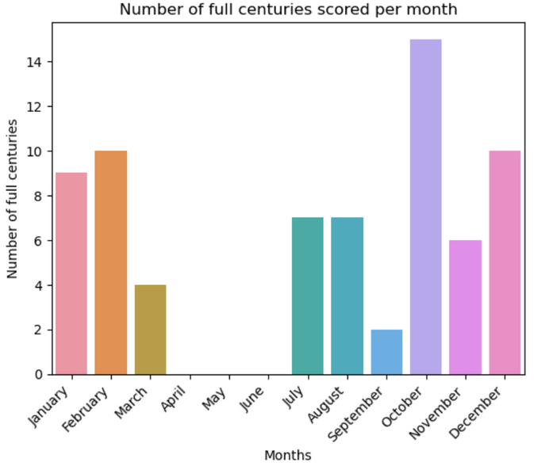
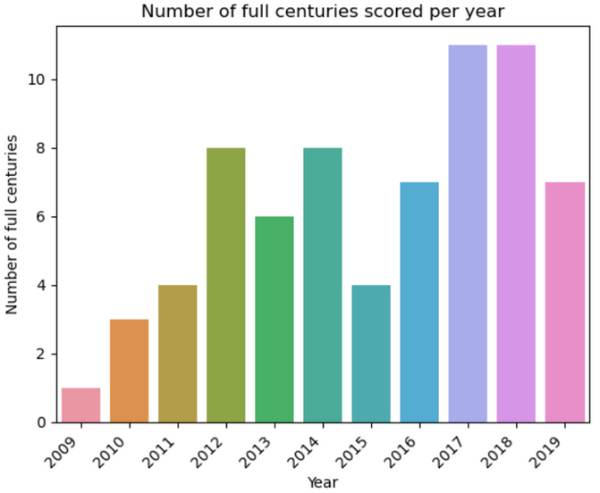

Slide 9
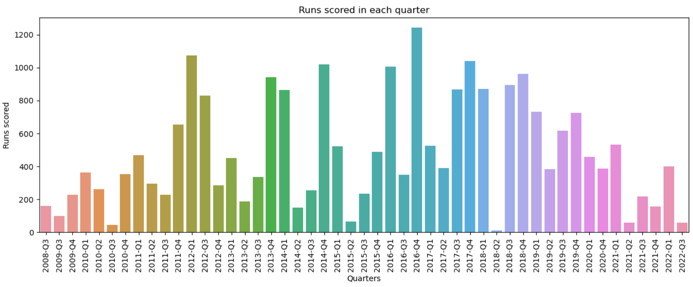
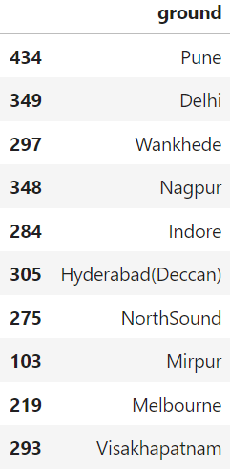
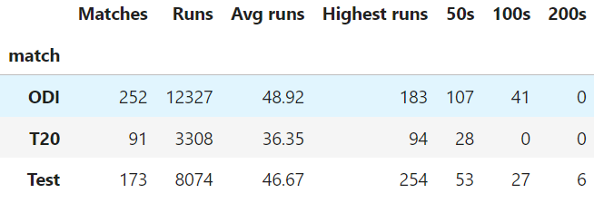

Slide 10
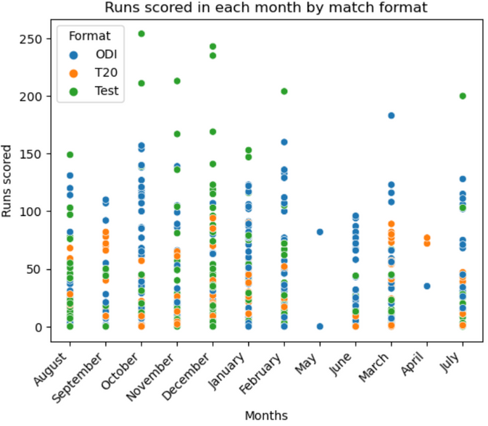
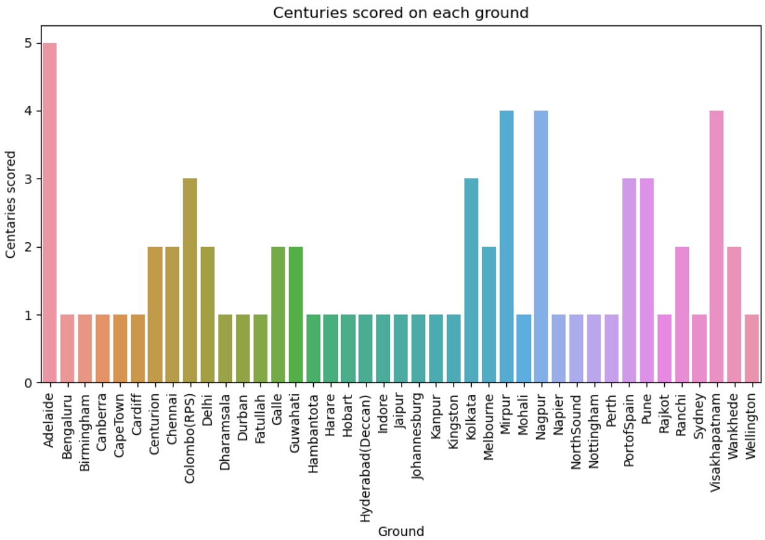
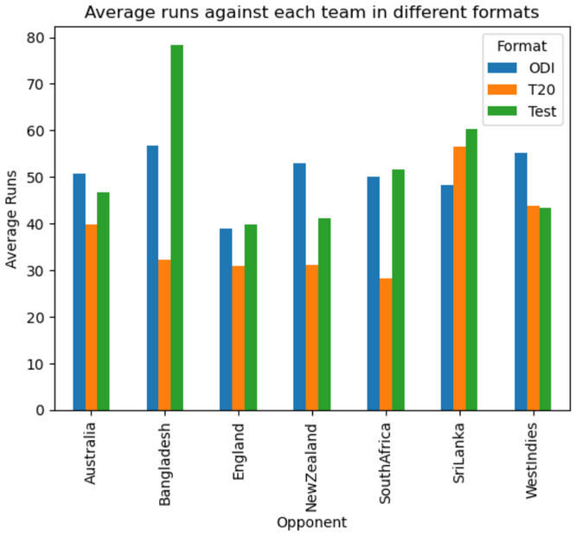

Slide 11

Findings
More than 50% of the runs he has scored are in ODIs.
Most runs are scored against Australia, England and West Indies in that order.
Most half centuries and full centuries are scored against Australia.
A bad form from Virat was recognised in the year 2015 (if previous four years are considered), as he scored less runs that year.
Virat scores the least runs in the months April and May.
Most half centuries were made in the years 2017 and 2019.
Most full centuries were made in the years 2017 and 2018.
Most runs were made in Pune.
Most centuries were made in Adelaide.

Slide 12

Thank you
Onkar Chaudhary

